Slide 1
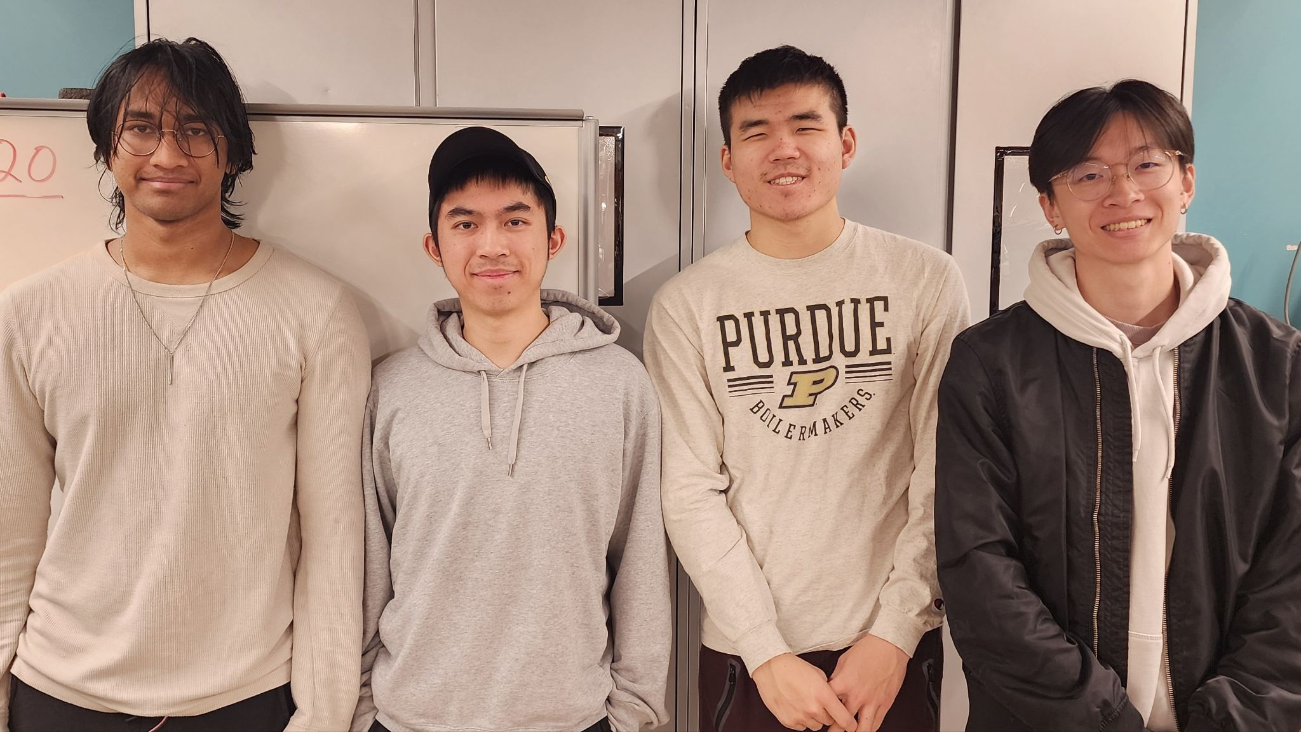

ECE477 MIDTERM DESIGN REVIEW: TEAM #20
Notes:
Identify ourselfs and say team roles

Slide 2


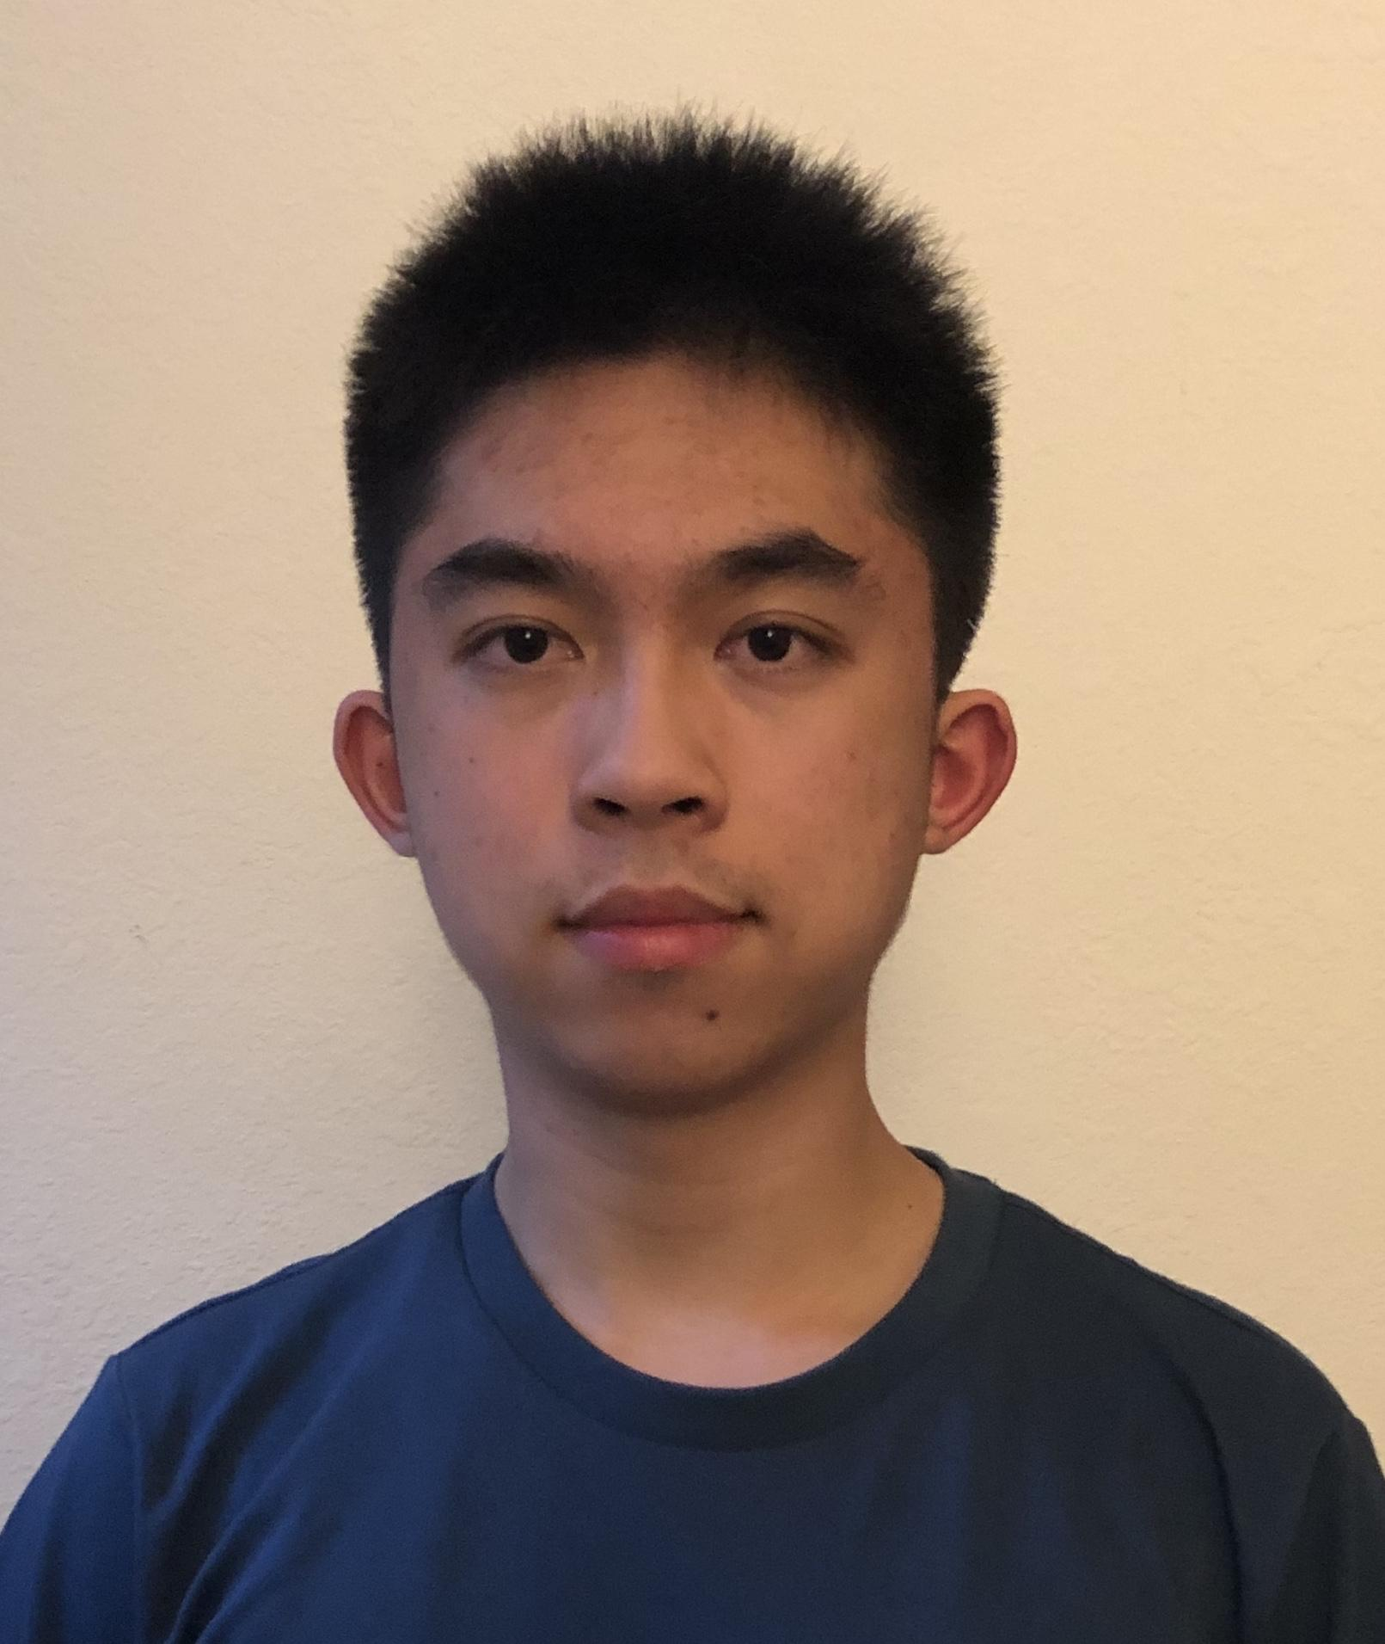

Team Members
Stanley So
Hardware Lead
Joshua Wai
Software Lead
Brandon Liu
Systems Lead
Abhijay Achukola
Team Lead
Notes:
Hannah

Slide 3
OUTLINE
Project Overview
Major Components
Block Diagram
Packaging Design
Electrical Schematic
PCB Layout
Prototyping Progress
Software Development Status
Project Timeline
Questions
Notes:
Abhijay

Slide 4

Project Overview
Encrypted USB Drive
USB Drive with password verification
2 methods of authentication: keypad and fingerprint
4 users
UI through LCD Display
Notes:
Stanley
We plan to make an encrypted USB drive. So imagine a regular usb drive, except you have to enter a password before you can access your files. That’s what we’re building. You enter your password through either a keypad or through a fingerprint sensor. There are also 4 different users on the same USB drive, all with different passwords. If a company has secrets that they want to protect, they might be interested in this product.
Keypad - For entering a passcode
Fingerprint Sensor - An alternate method of verification
LCD Display - For displaying instructions / information
Flash ICs - For storing data
Microcontroller - For communicating with the host computer through USB and for communicating with all the other components

Slide 5
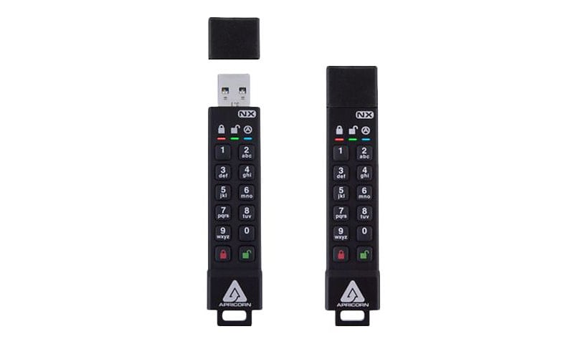
Project Overview
Encrypted USB Drive
Main competitor: Aegis Secure Key 3NX
Pros | Cons
very small and portable | no fingerprint sensor only one user
Notes:
Stanley
If the company wants to keep their files secure, but they want 4 employees to only have access to their own files, they would have to buy 4 different thumb drives. If each employee doesn’t have to use the files at the same time, the company can just share one thumb drive between 4 different employees. That will save money.

Slide 6
PSDRS
PSDR #1 (Hardware): An ability for the microcontroller to communicate with the LCD display over SPI
PSDR #2 (Hardware): An ability for the flash memory chip and the microcontroller to communicate over SPI
PSDR #3 (Hardware): An ability for the microcontroller and a host computer to communicate over USB
PSDR #4 (Hardware): An ability for the fingerprint sensor and the microcontroller to communicate over UART
PSDR #5 (Software): An ability for the microcontroller to use the fingerprint sensor and keypad input to transition between the User Select, Receiving Password, Unlocked, Change Fingerprint, Change PIN, and Locking states.
STRETCH PSDR #1 (Software): An ability for the microcontroller to encrypt and decrypt the data on the flash chips.
Notes:
-psdr1: we need a lcd display for the user to interface with
-psdr2: for our drive to work we need it to be able to store data into memory
-psdr3: since we have usb built in to our microcontroller we can directly communicate to the host computer to transfer data
-psdr4: we opted to put a fingerprint sensor so that there is a convenient alternative to access the usb drive
-psdr5: with all these components, we will need to write software to tell lcd what to display
-starch psdr: and if we have extra time to spare, we will implement AES encryption for the data so that someone cant just open our case, desolder the flash chips and get all the data

Slide 7
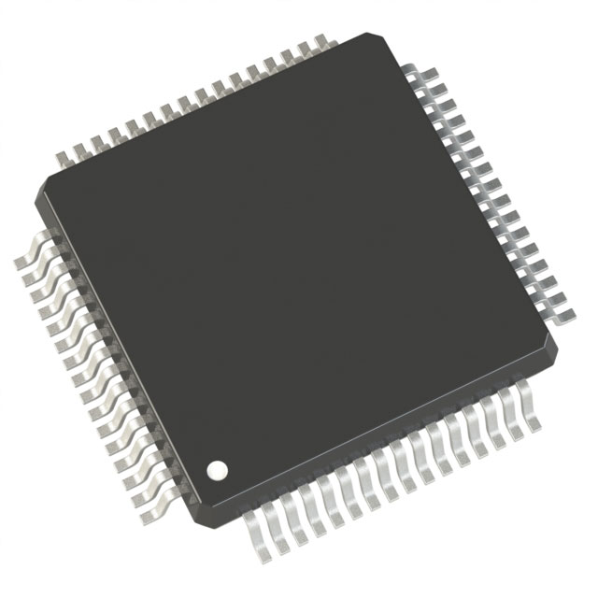
MAJOR COMPONENTS
MICROCONTROLLER
Name | STM32L443RCT6 | STM32H7A3RGT6 | STM32F401RCT6TR
Price | $4.67 | $14.41 | $5.54
USB on Chip | Yes | Yes | Yes
Package | 64-LQFP | 64-LQFP | 64-LQFP
Speed | ARM M4, 80 MHz (Low Power) | ARM M7, 280 MHz (High Performance) | ARM M4, 84 MHz (Standard)
Notes:
Abhijay

Slide 8
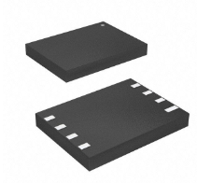
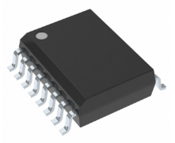
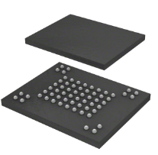
MAJOR COMPONENTS
Flash IC Chips
Name | MT29F4G01ABAFDWB-IT:F | W25N01GVSFIG | MT29F4G08ABADAH4:D TR
Price | $3.86 | $4.30 | $5.35
Data Transmission | Quad SPI | Quad SPI | Parallel
Package | 8-UDFN | 16-SOIC | 63-VFBGA
Data Capacity | 4 GB | 1 GB | 4 GB
Notes:
Abhijay

Slide 9
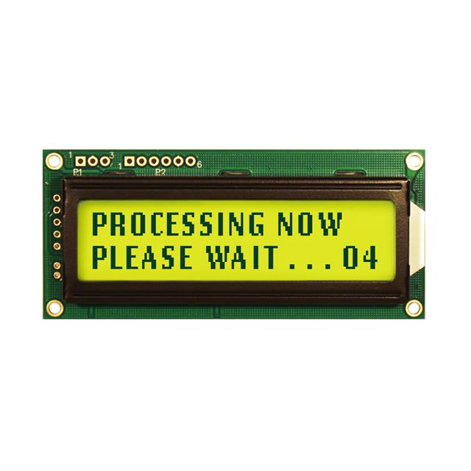
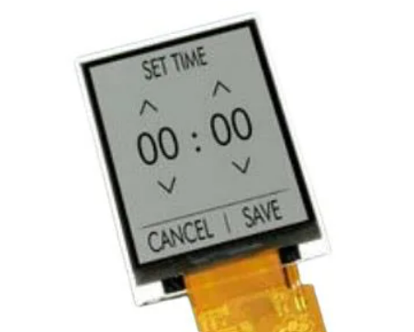
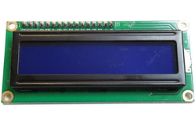
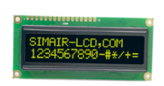
MAJOR COMPONENTS
Liquid Crystal Display
Name | SEH1602A | NHD-0216K3Z - 100 kHz max clock, 5V & 18 mA operation | EA TFT024-23ATNN | 1602A - 26076
Price | $14.50 | $23.75 | $41.53 | $3.50
Uses SPI | Yes | Yes | Yes | No, Parallel
Is 2 Line Display | Yes | Yes | No | Yes
Purchasable | No, Potentially Banned Vendor | Yes, Digikey | Yes, Mouser | Yes, Digikey
Notes:
Brandon
Choose the major (electrical) components being utilized by your design. For each component, provide a brief description of what it is, relevant specifications, and what it will do. Also, provide a couple of alternative components and justify your choice. Examples of major components include the microcontroller, motors, wireless interfaces, power converters and regulators. Examples of relevant specifications include operating speed (uC), number of I/O (uC), stall current (motors), operating voltage, and expected current consumption.
Our project uses an LCD to display instructions and information to the user whether to ask for usernames, passwords / fingerprint etc and we picked the Newhaven Display operating at 100 kHz max and typically operating at 5 V and 18 mA. This was the best choice out of the other LCDs we looked at because we decided we only needed a 2 line display and we wanted to use SPI because it was a protocol that we were familiar with. We had access to the SEH 1602A on the left, an LCD used in 362 but with our microcontroller and the HAL we are using, parts of the 362 LCD requires 10 bits for certain commands to be sent and that was not doable via the HAL which increments in 8 bits. Additionally, even if that wasn’t an issue, the suppliers of that particularly microcontroller seem to be banned online so we decided to use the newhaven which i found on our lab bench and is compatible with the HAL driver we’re using and we were able to interface with it

Slide 10
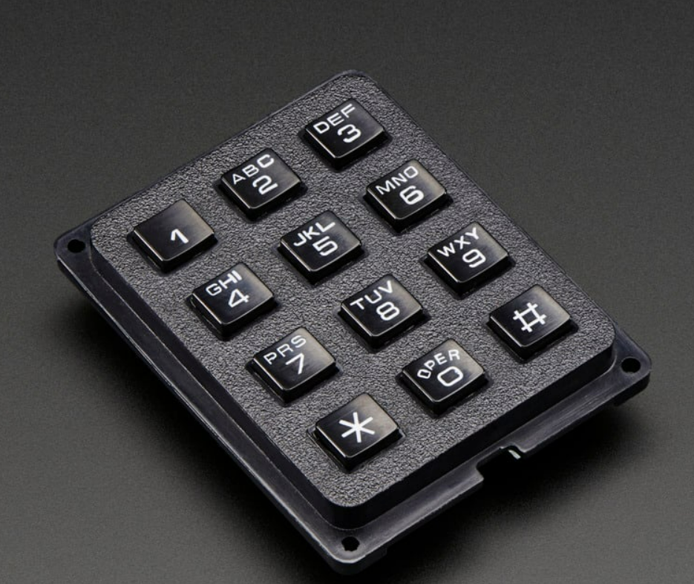
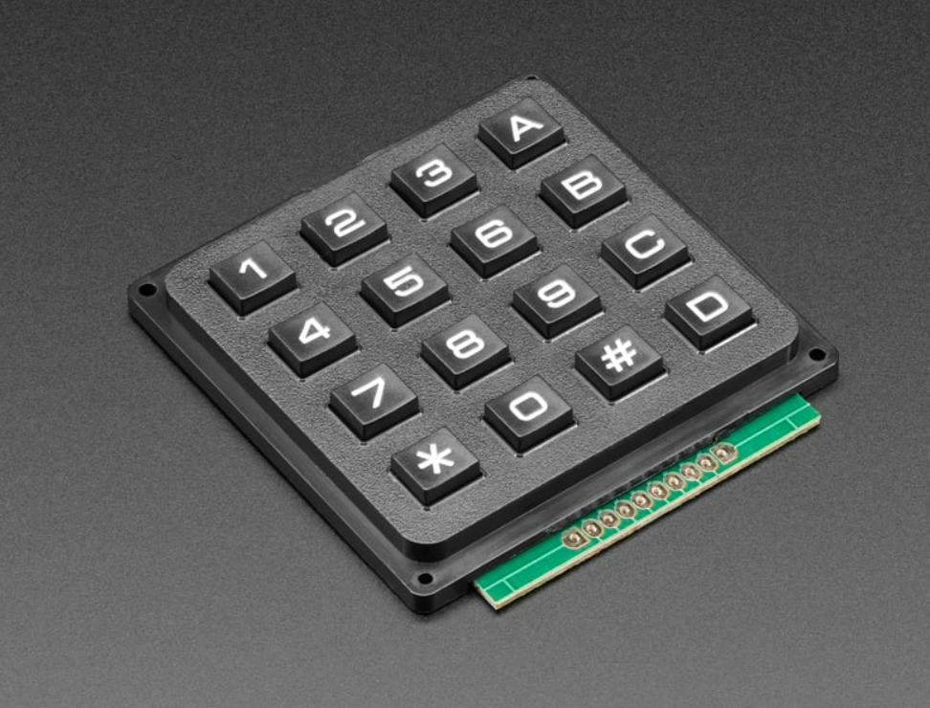
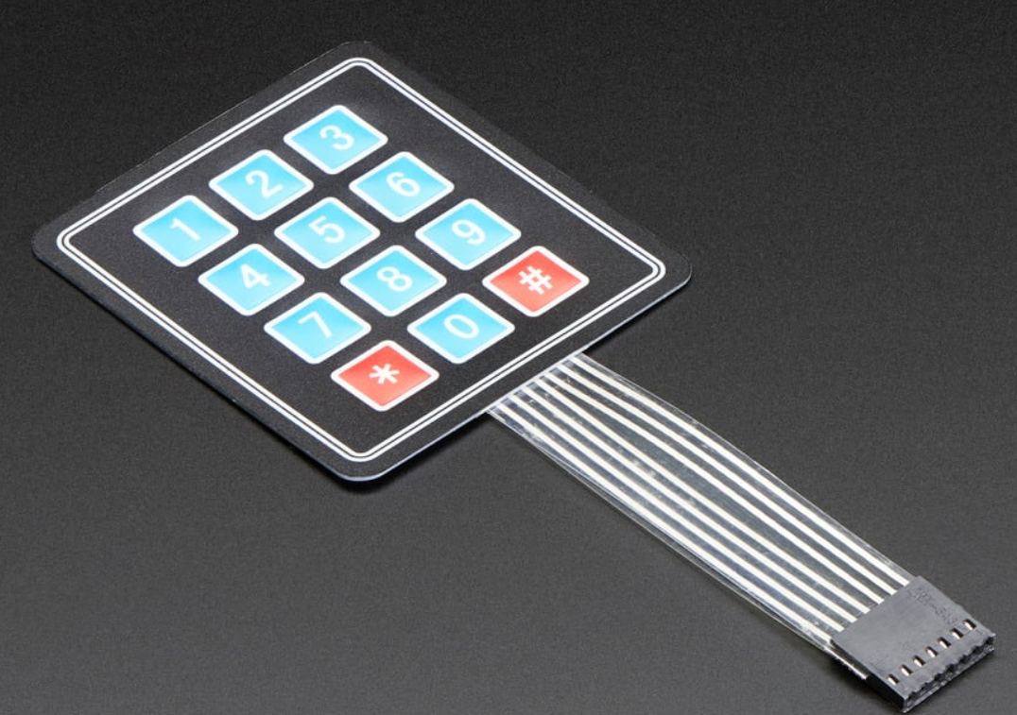
MAJOR COMPONENTS
Keypad
Name | Adafruit 4x4 Matrix Keypad | Adafruit 3x4 Matrix Keypad | Adafruit EA TFT024-23ATNN
Price | $5.95 | $8.50 | $3.95
Waterproof | Probably Not | Probably Not | Yes
Responsive | Yes | Yes | No
Dimensions | 69.0mm x 65.5mm x 9.7mm | 64.00mm x 51.00mm x 11.00mm | 70mm x 77mm x 1mm
Notes:
Brandon
in order to enter user id and passwords, we decided to allow the user to do so via a keypad. we didn’t think we needed that many keys because there are only 4 users, but we ended up prototyping with the 4x4 anyway even though we plan on using the 3x4. we picked the phone style keypad because even though it’s not as weatherproof as the membrane one, we disregarded that metric and according to a TA, the membrane one is hard to solder

Slide 11
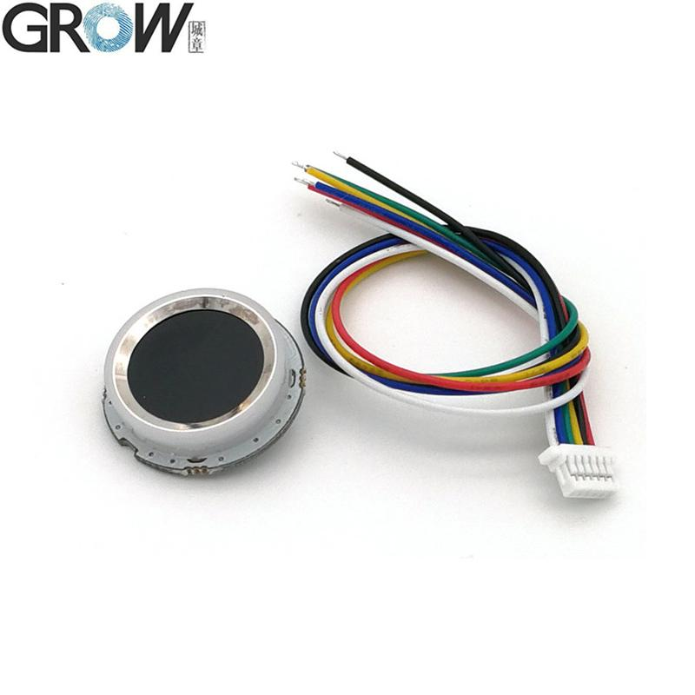
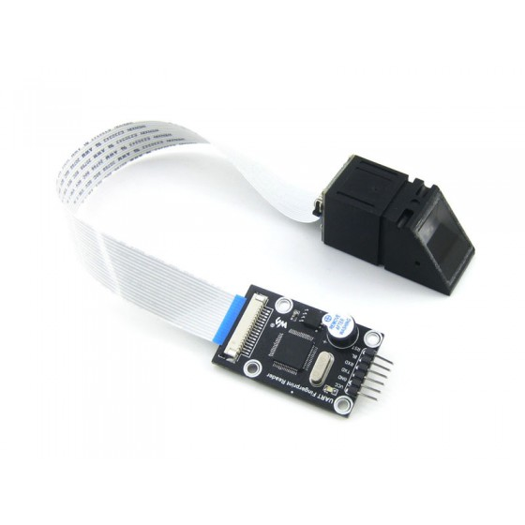
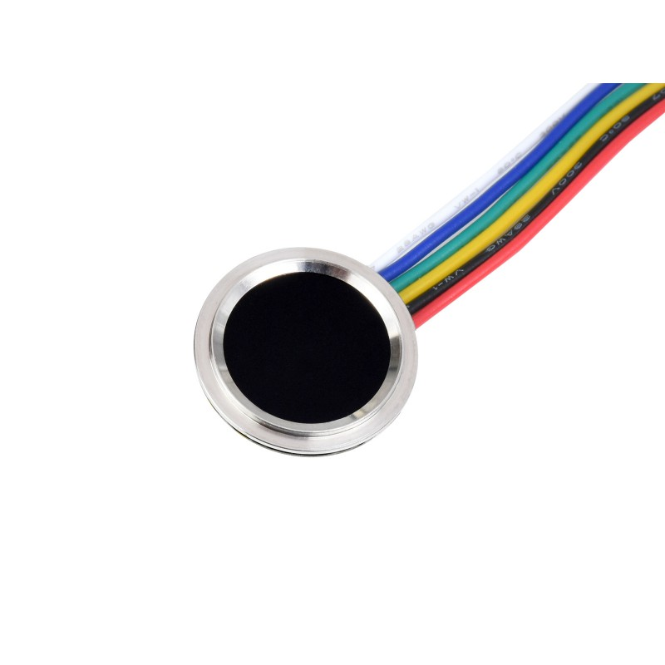
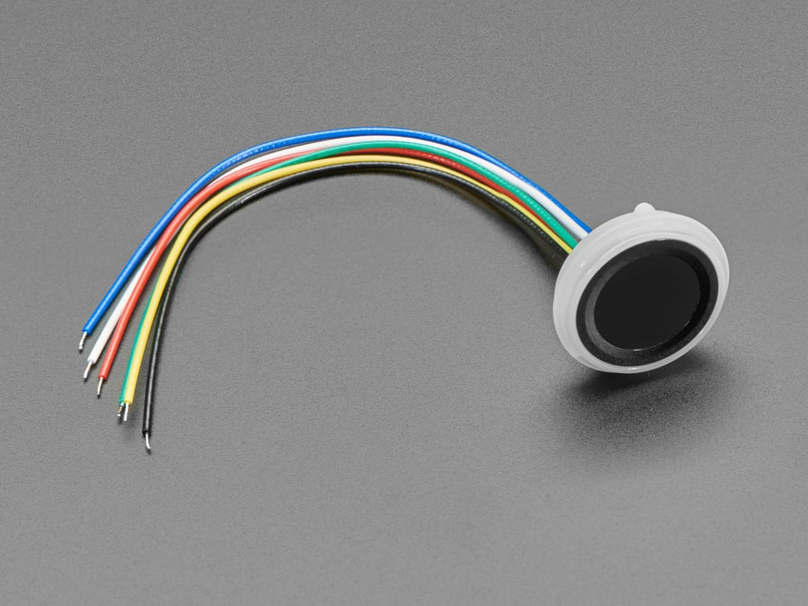
MAJOR COMPONENTS
Fingerprint Sensor
Name | GROW R502-A | GROW R558-S | Waveshare UART Fingerprint Reader A | Waveshare UART Fingerprint Reader D
Price | $12.20 | $19.95 | $42.99 | $16.99
Fingerprint Capacity | 200 | 100 | 4000 | 150
Image Dimensions | 192 * 192 pixels | 112 * 88 pixels | 248 * 296 pixels | 160 * 160 pixels
Sensing Type | Capacitive | Capacitive | Optical | Capacitive
Notes:
Stanley

Slide 12
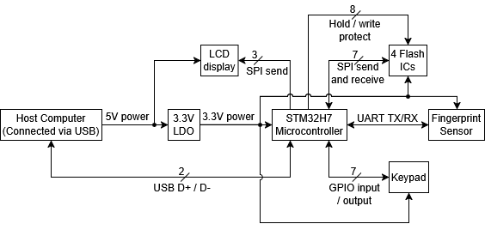
BLOCK DIAGRAM
Notes:
Stanley

Slide 13
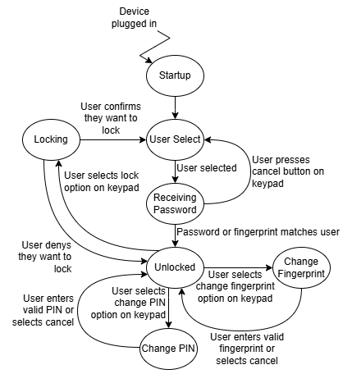
STATE MACHINE
Notes:
Brandon
on startup, the lcd should ask the user to pick an id from the range of 4 numbers (representing 4 users) and then a password will be prompted. for now, the password will probably just be a string of digits and the pound or star key will either be used to confirm or cancel authentication. the user could also simply scan their fingerprint (similar to iphone functionality) to unlock the the data corresponding to the user id. we haven’t decided which keys will be the transitioin which states but we are pretty flexible because the user only needs to type user id and password before reaching other functionality. the lcd will give the user a selection of options and describe which keys to press to take the user along the next steps he or she desires

Slide 14
PACKAGING DESIGN
A casing for the device will be 3D printed
Dimensions: 61.62mm x 103.67mm x 23.3mm
CAD drawing is still in progress
Once PCB is fabricated, will confirm dimension then print utilizing the Bechtel Innovation Design Center
Notes:
Joshua

Slide 15
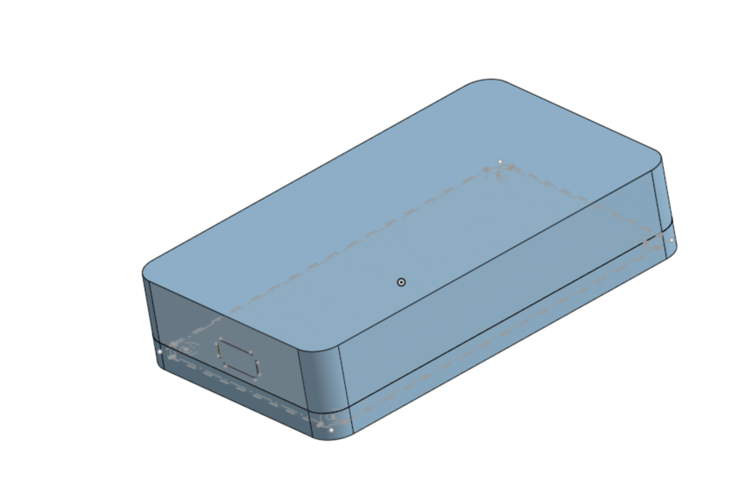
PACKAGING DESIGN
Notes:
Joshua

Slide 16
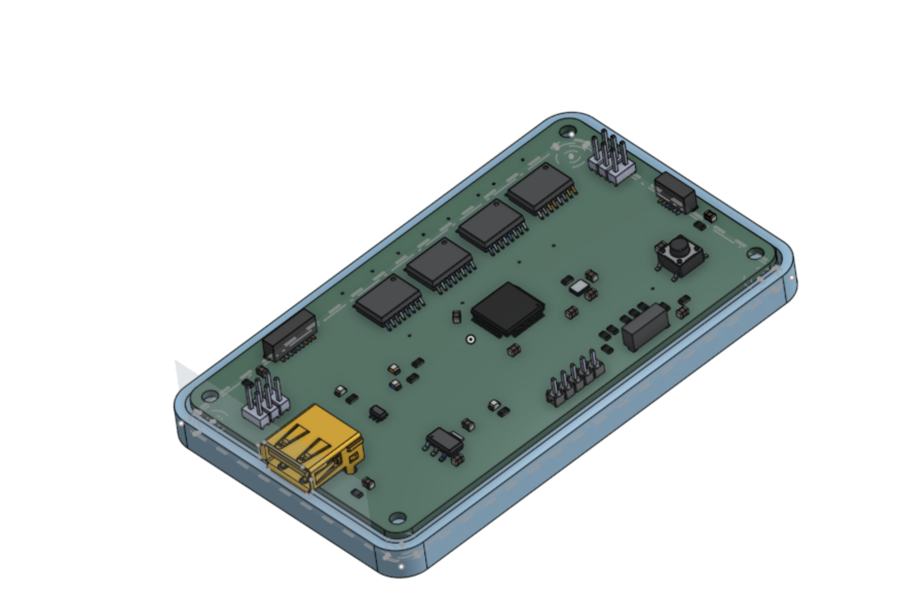
PACKAGING DESIGN
Notes:
Joshua

Slide 17
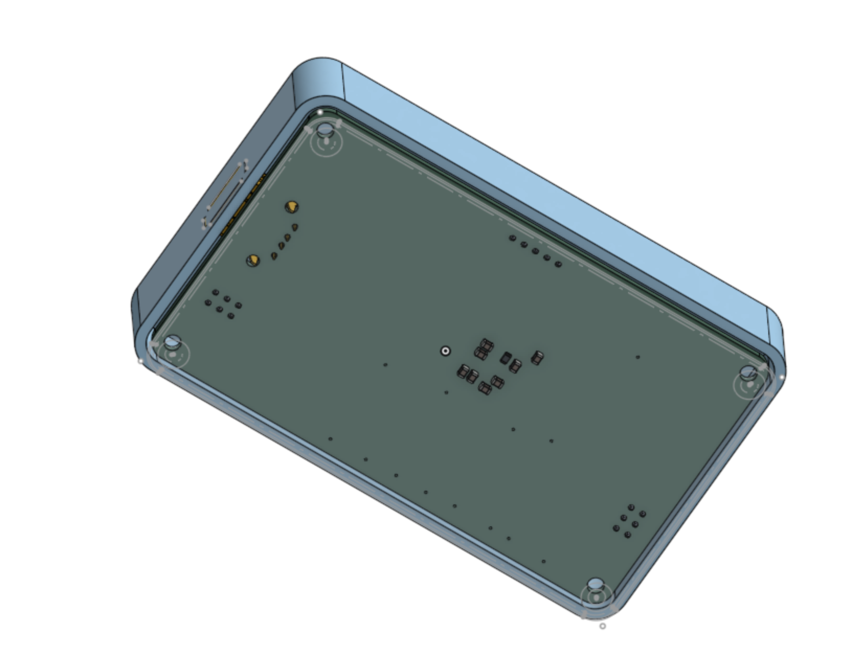
PACKAGING DESIGN
Notes:
Joshua

Slide 18
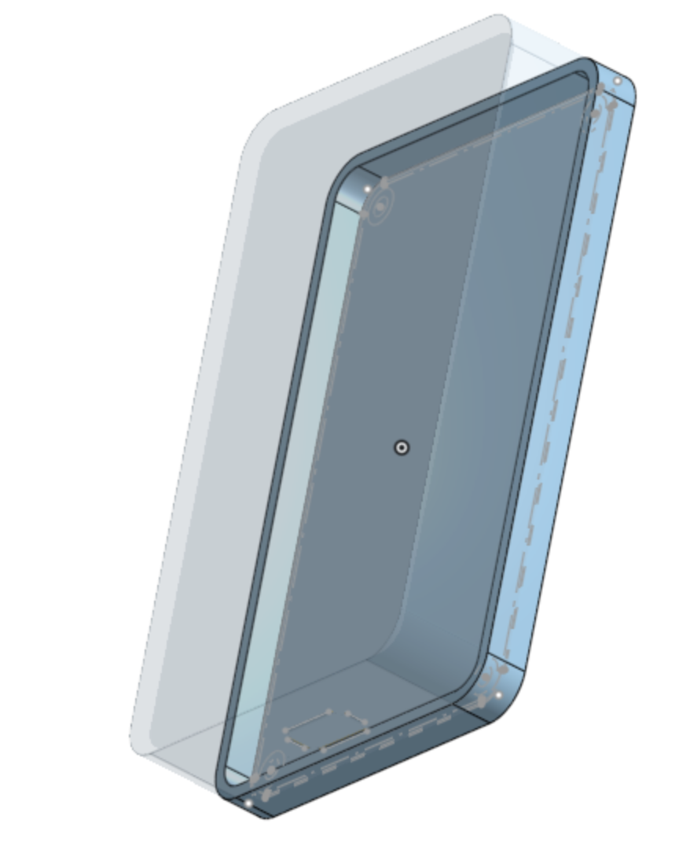
PACKAGING DESIGN
Notes:
Joshua

Slide 19
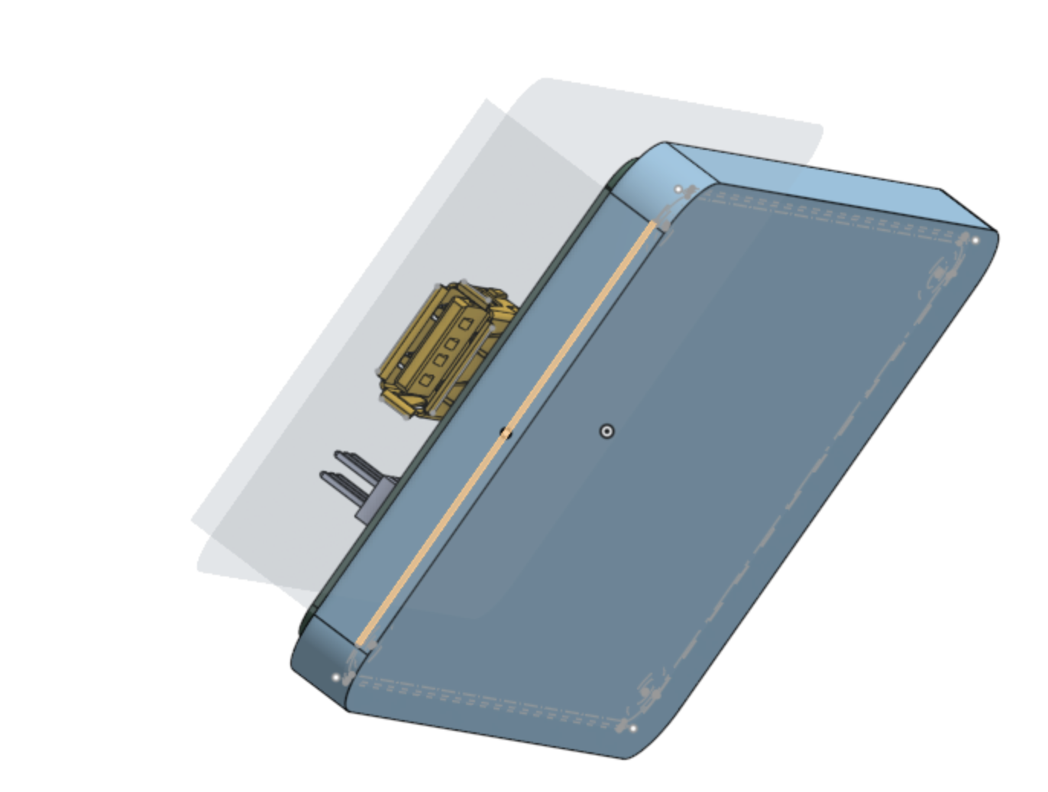
PACKAGING DESIGN
Notes:
Joshua

Slide 20
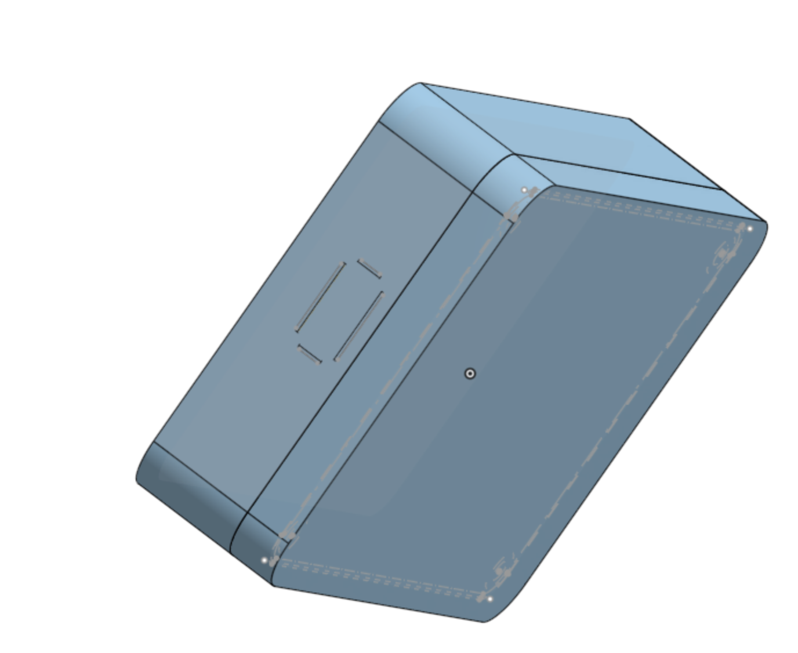
PACKAGING DESIGN
Notes:
Joshua

Slide 21
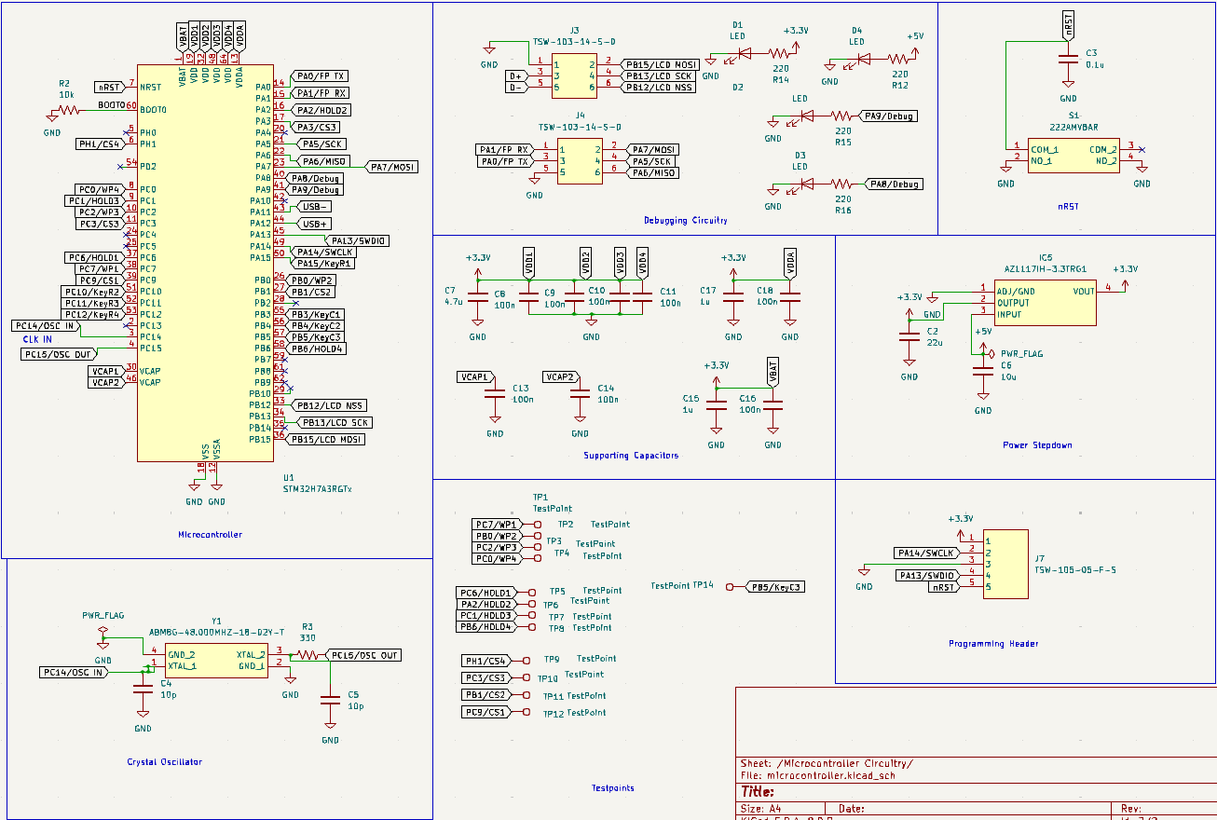
ELECTRICAL SCHEMATIC
MiCROCONTROLLER PINS AND CAPACITORS
Notes:
Abhijay

Slide 22
ELECTRICAL SCHEMATIC
MiCROCONTROLLER SUPPORTING CIRCUITRY
Notes:
Abhijay

Slide 23
ELECTRICAL SCHEMATIC
DEBUGGING CIRCUITRY
Notes:
Abhijay

Slide 24
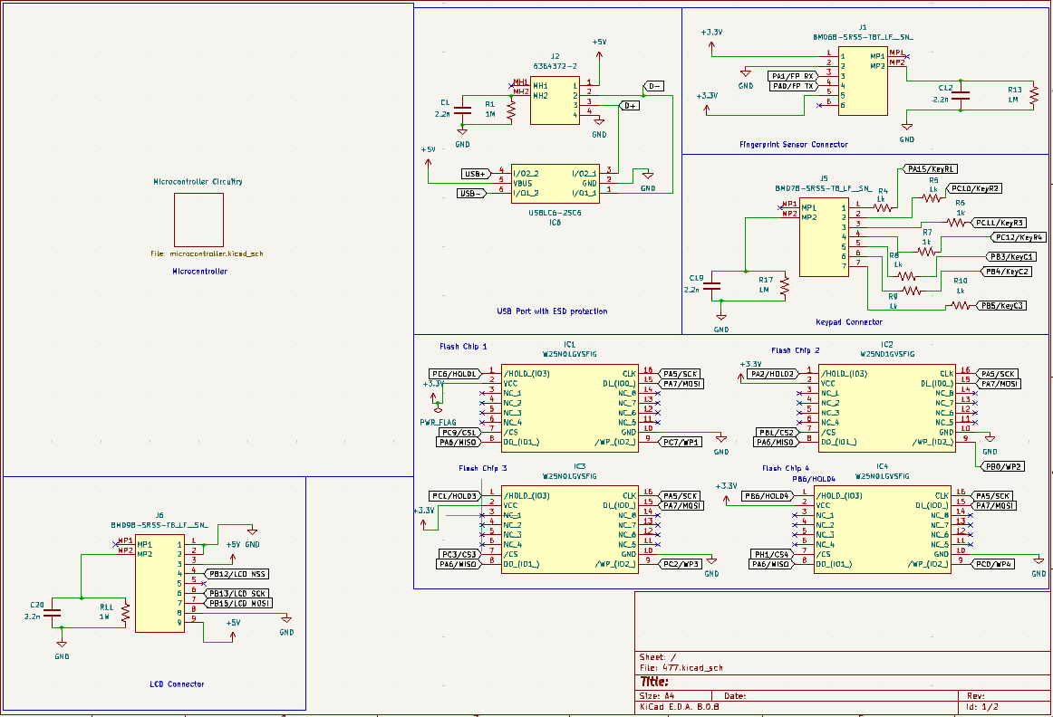
ELECTRICAL SCHEMATIC
FLASH IC WIRING
Notes:
Abhijay

Slide 25
ELECTRICAL SCHEMATIC
OTHER COMPONENT CONNECTOR WIRING
Notes:
Abhijay

Slide 26
ELECTRICAL SCHEMATIC
USB CONNECTOR WIRING
Notes:
Abhijay

Slide 27
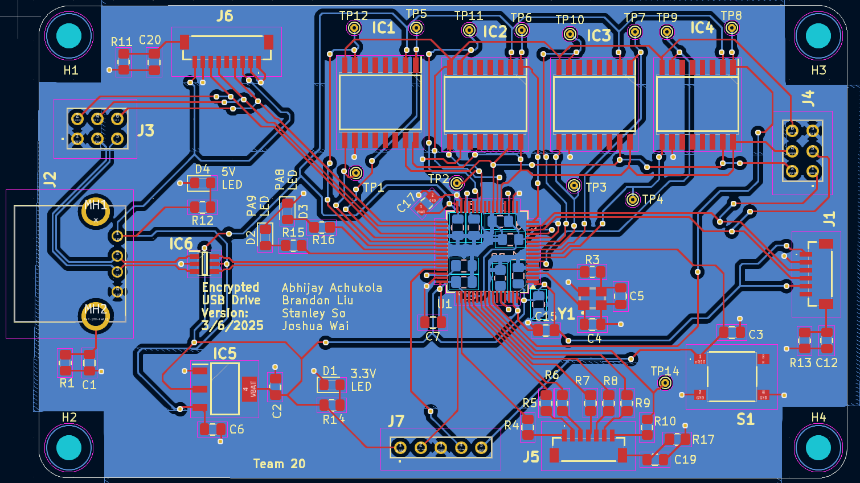
PCB LAYOUT
TOP LEVEL
Notes:
Abhijay

Slide 28
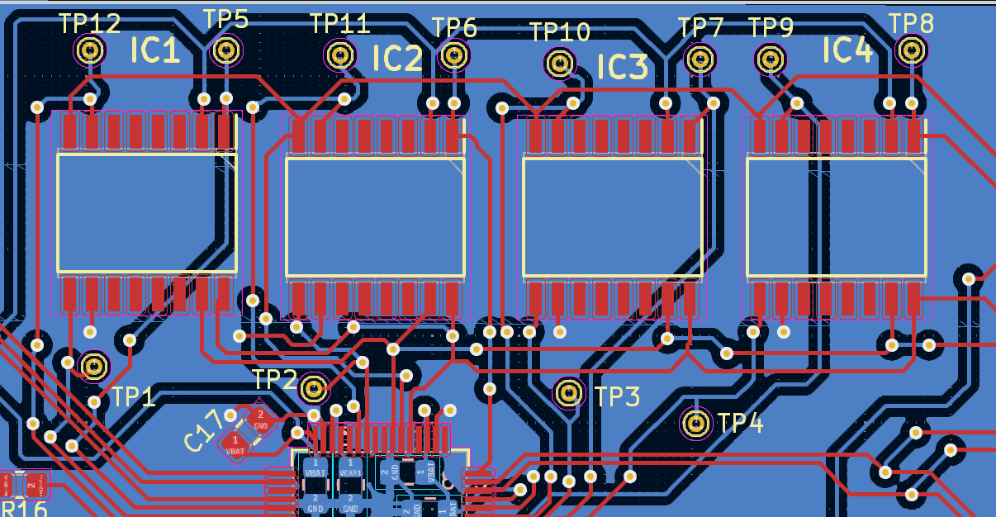
PCB LAYOUT
FLASH ICs
Notes:
Abhijay

Slide 29
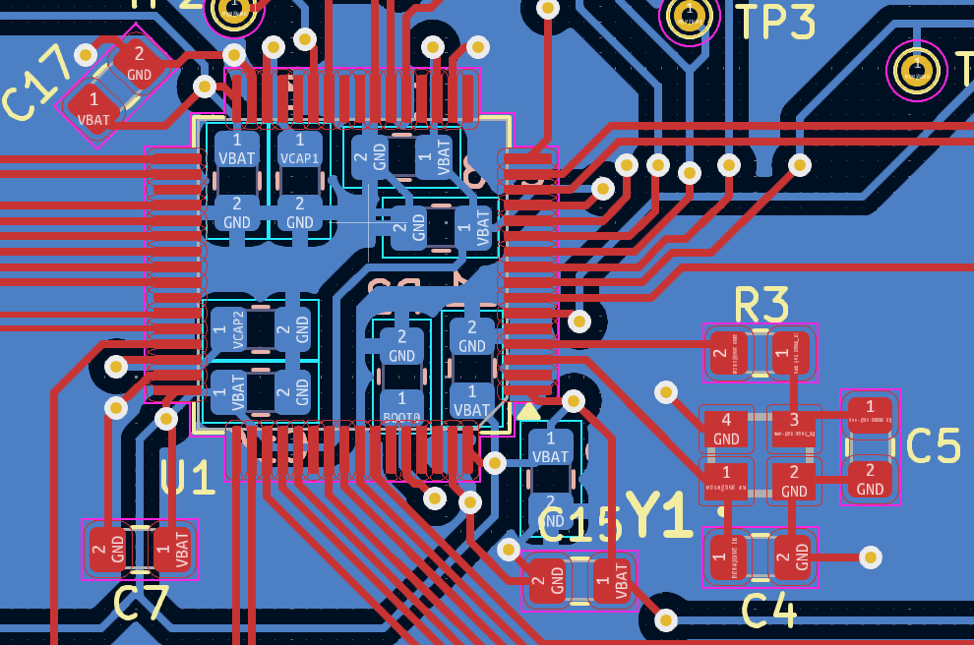
PCB LAYOUT
Microcontroller
Notes:
Abhijay

Slide 30
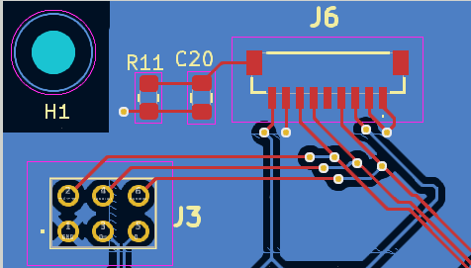
PCB LAYOUT
LCD WIRING
Notes:
Abhijay

Slide 31
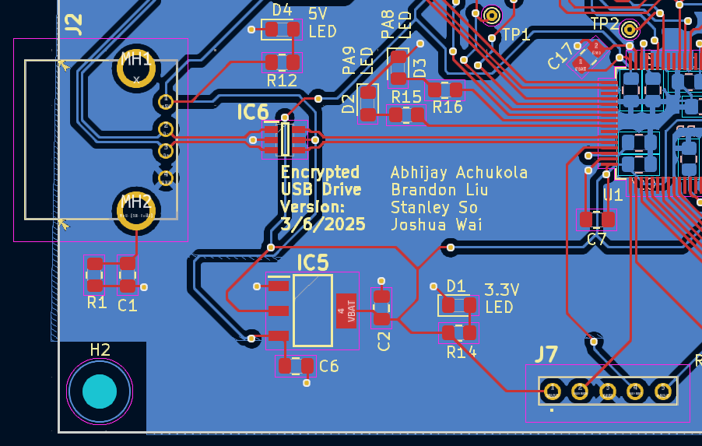
PCB LAYOUT
USB WIRING
Notes:
Abhijay

Slide 32
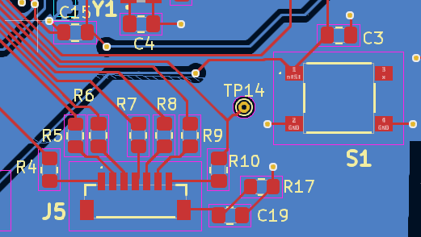
PCB LAYOUT
KEYPAD WIRING
Notes:
Abhijay

Slide 33
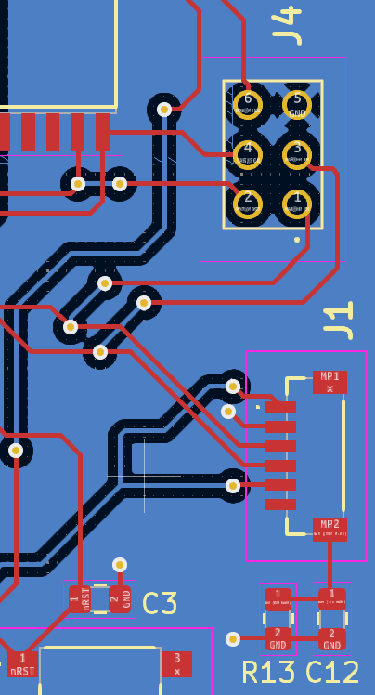
PCB LAYOUT
FINGERPRINT SENSOR WIRING
Notes:
Abhijay

Slide 34
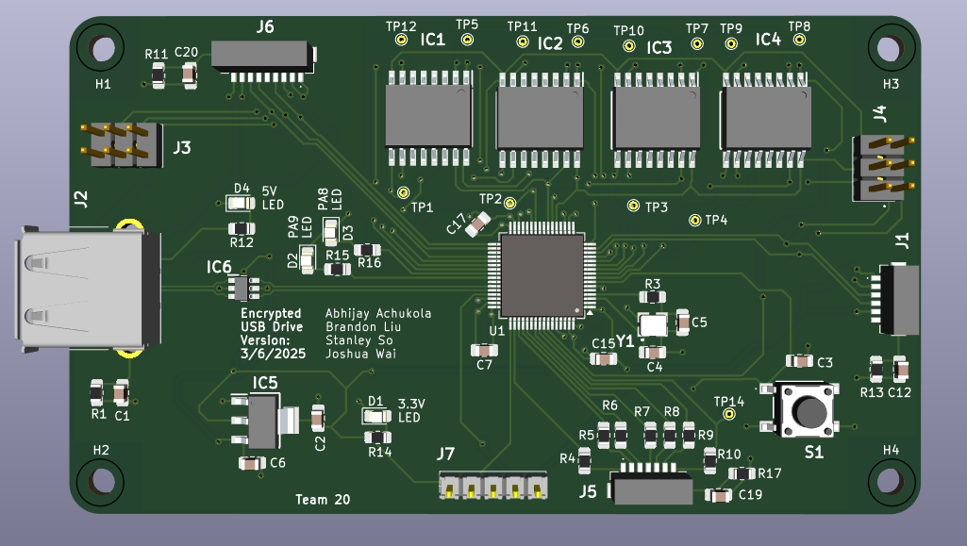
PCB LAYOUT
3D Top View
Notes:
Abhijay

Slide 35
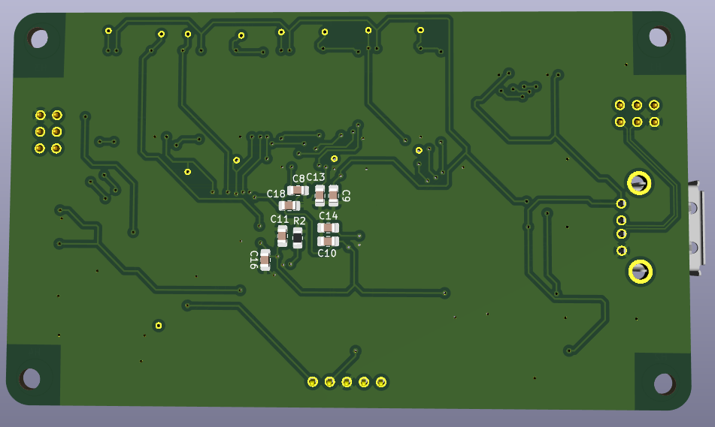
PCB LAYOUT
3D Bottom View
Notes:
Abhijay

Slide 36
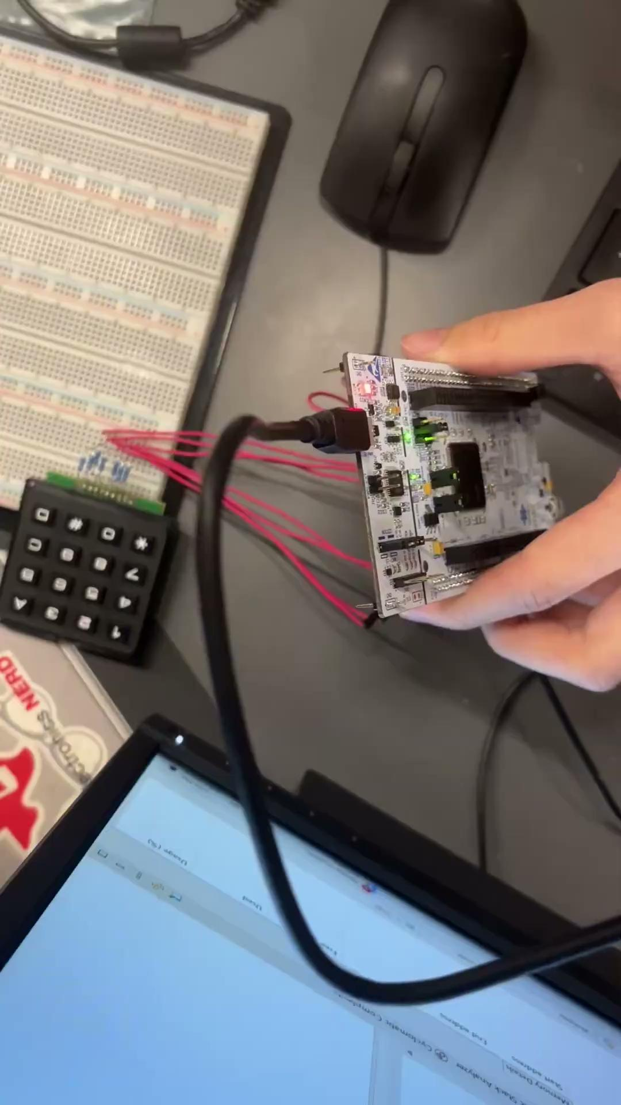
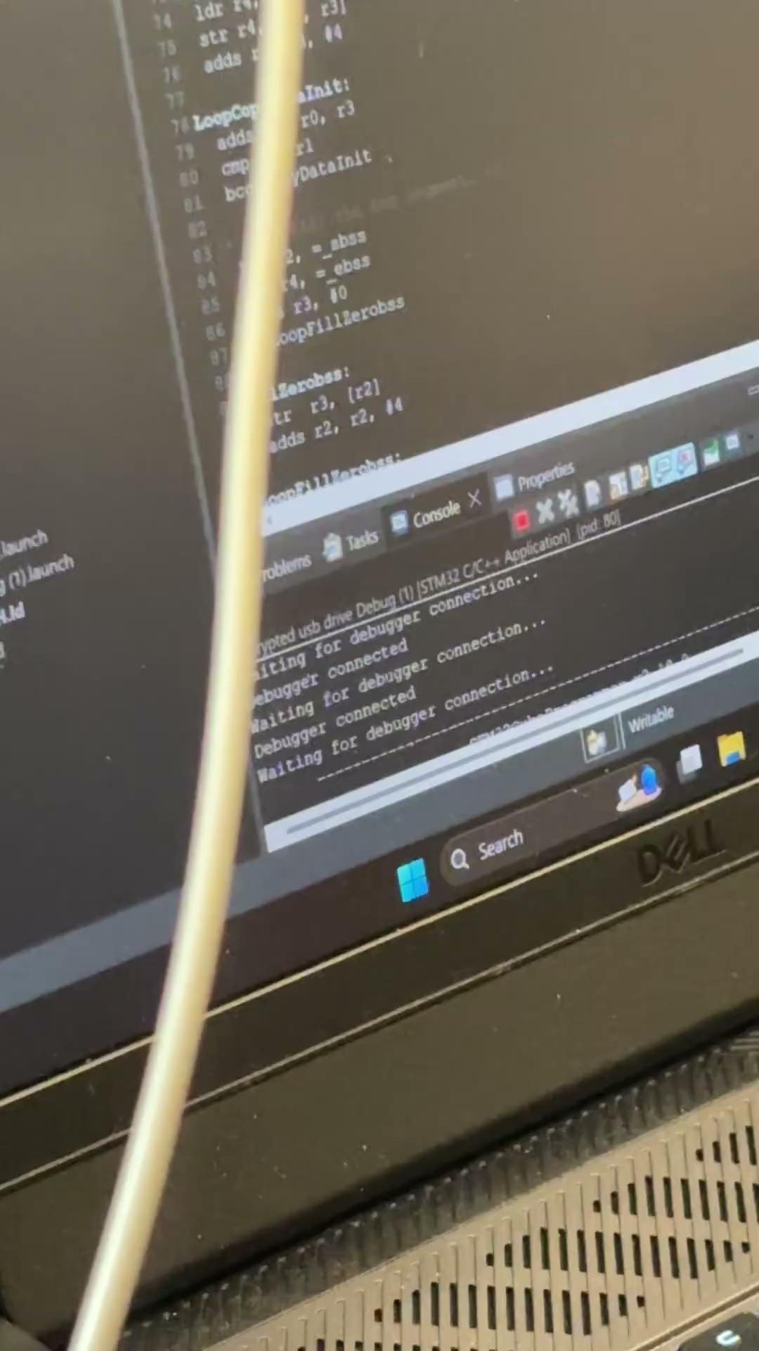
Prototyping Demos / Progress
Keypad
Fingerprint Sensor
Notes:
Stanley
Keypad is 1 second debouncing

Slide 37
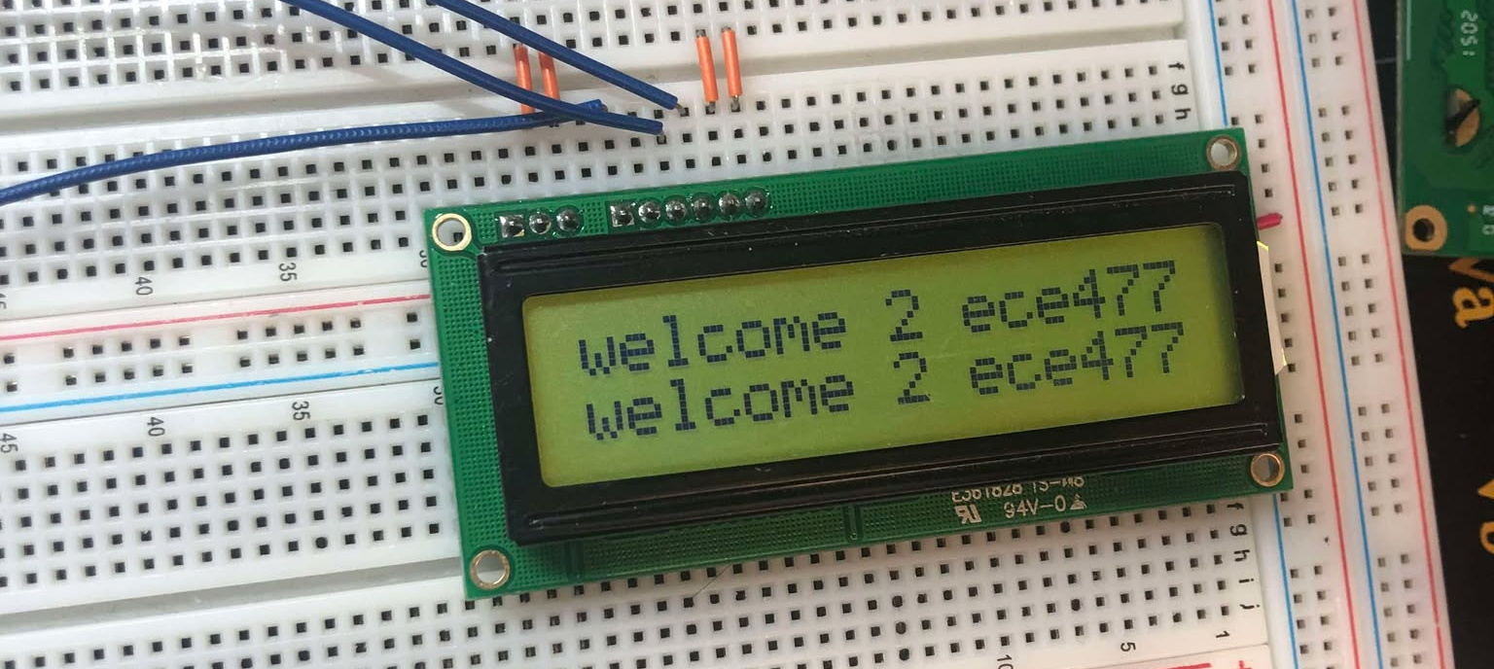
Prototyping Demos / Progress
LCD Displaying on both lines
Notes:
Brandon
here we have the lcd progress which is successfully integrated with the microcontroller
custom text can be displayed on both lines, and although not shown here, the lcd can be disabled, cleared, and re-enabled

Slide 38
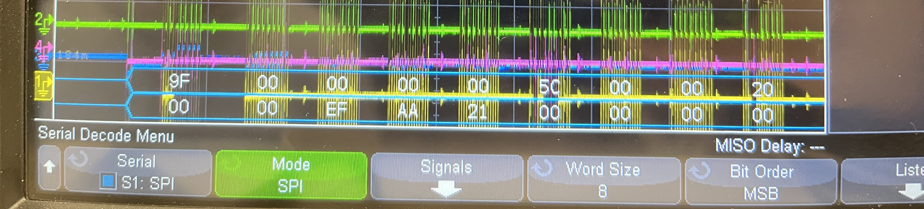
Prototyping Demos / Progress
Flash IC Responding (Noisy)
JEDEC ID: EFh AAh 21h
Notes:
Brandon
we also have the flash IC partially successful in interfacing with the microcontroller
we simply retrieve a JEDEC ID built in by the manufacturer which is EF AA 21 in hex and we retrieve it by sending 9F in hex and 8 dummy clocks
there’s quite a bit of noise but we can see at the MISO line at the bottom that the slave responds with the JEDEC ID
unfortunately, the master also accidentally sends other non useful bytes which is unintended and needs to be debugged in the future

Slide 39
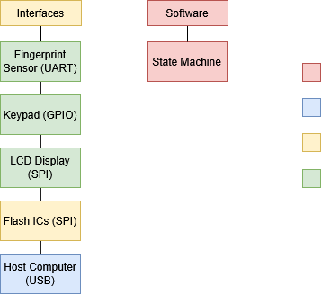
SOFTWARE DEVELOPMENT STATUS
Not Started
In Development
In Testing
Completed
Notes:
Brandon
so quick recap, coding wise interfacing is trucking along with just a little more functionality needed to be tested for the flash ics and we’re still moving along in allowing the host computer to communicate over USB and the state machine isn’t coded out yet

Slide 40
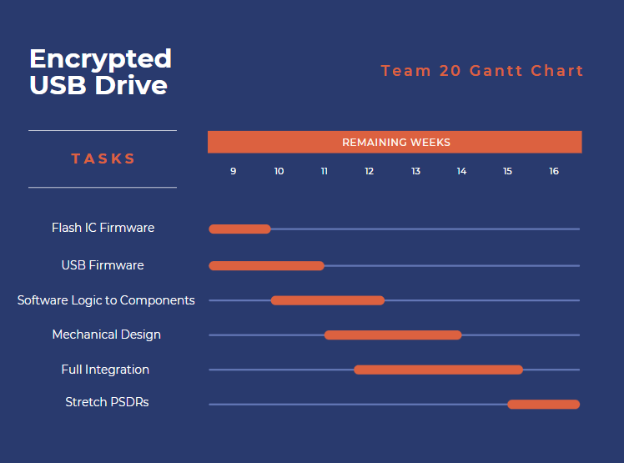
PROJECT TIMELINE
GANTT CHART
Notes:
Brandon
so given the current software development status, we obviously want to finish the flash ic and USB firmware, and once those tasks make some progress. we already have the state machine thought out so once we sort of code that together, we can start adding software logic to components that are successfully interfaced with the MCU. an example of that would be to finish writing the libraries for the LCD so that it doesn’t just say welcome to ece477, but display important information to the user such as asking the user for pick options, enter passwords and user id, scan thumb print etc
once that is moving along, we want to get going on mechanical design and full integration (begin working on all the components communicating with the MCU and see if the functionality matches our state machine and if we have time after we’re done, we can attempt the stretch PSDRs

Slide 41
3D PRINTING
Questions?

